Slide 1
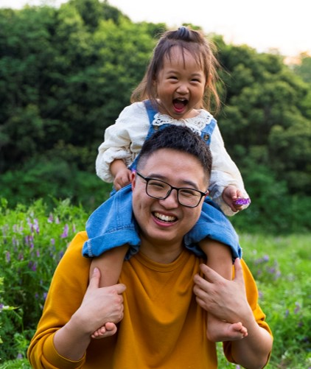


YesNM Portal
Demonstration Meeting for
Early Childhood Education & Care Department
11/05/24

Slide 2
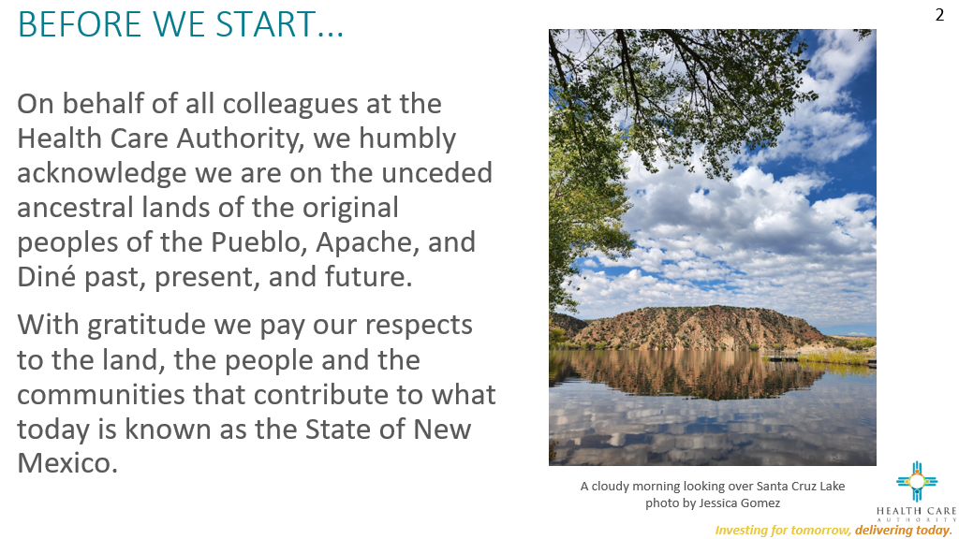

Slide 3

Meeting Agenda
Time (MT) | Agenda Item | Leader | Description
8:00am MT | Welcome Design Approach | Shanita Harrison | Design Approach
8:10am MT | YesNM Portal Demo | Subhash, Sindhuri, Sheela | YesNM Unified Portal Demo
8:25am MT | Questions & Answers | Shanita Harrison | Open mic to answer verbal and written questions/comments

Slide 4
Design Approach

Slide 5
Experience Drivers
01
02
03
Anticipate
My Needs
Show Me
The Way
Mind the
Gap
04
05
06
Give Me the
Whole Story
Speak My
Language
Build
My Confidence

Slide 6
Experience
Customers progress through
each phase of the experience through digital journeys
entice
enter
engage
extend
exit

Slide 7
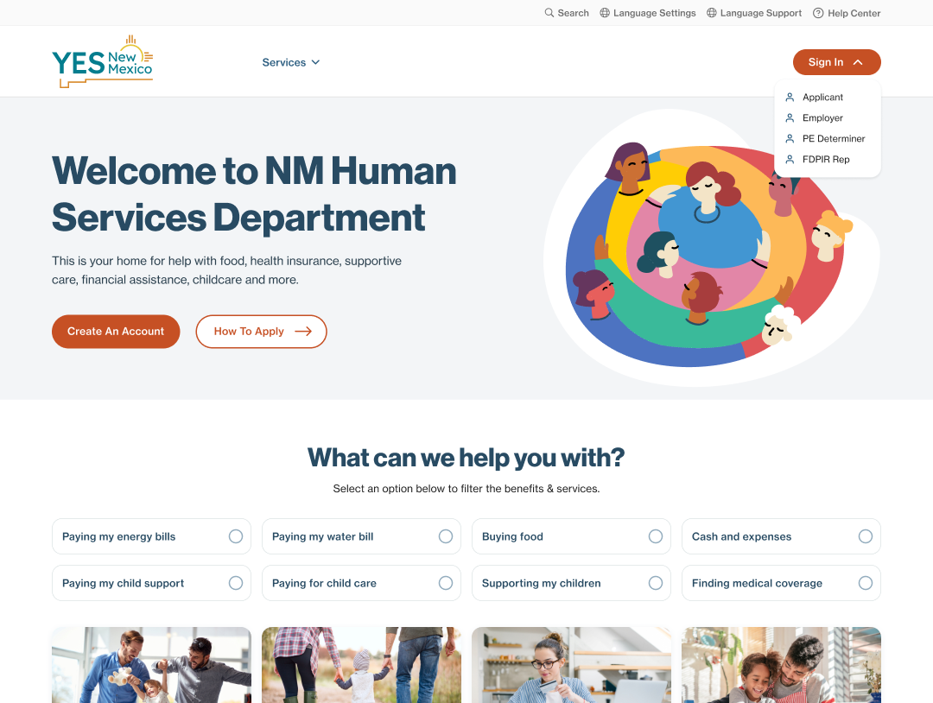
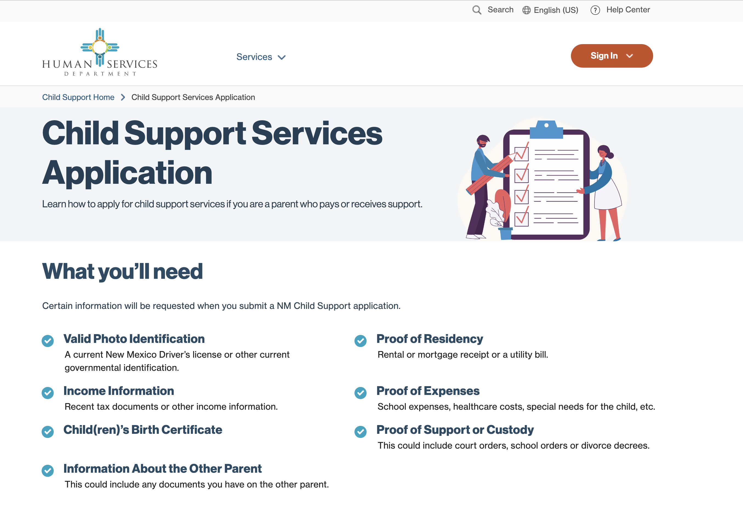
Experience
entice
enter
engage
extend
exit
I want to research and see what benefits are right for me.
I want to know what child support services are available.
Homepage
Benefits and services selection
Child support application overview

Slide 8
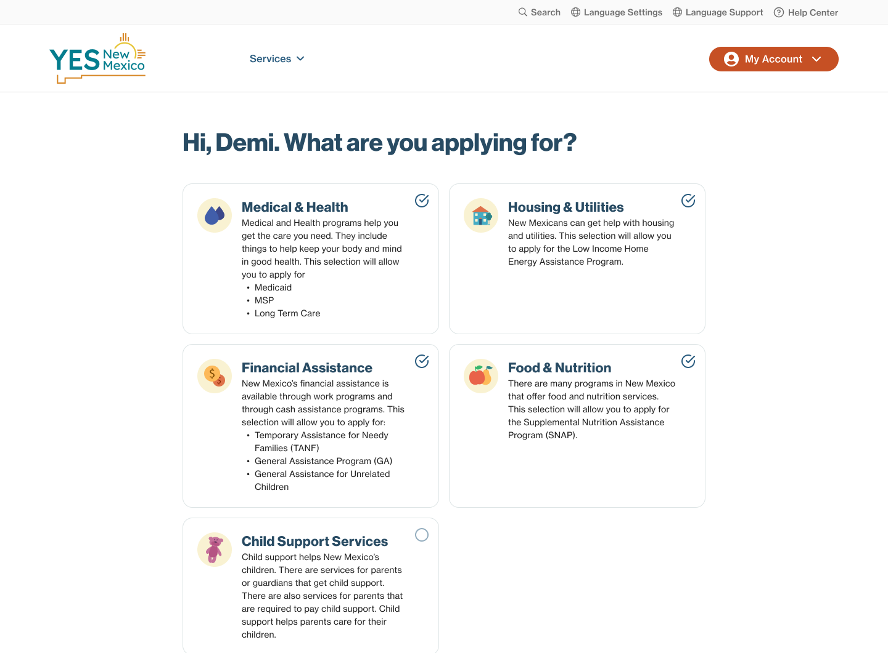
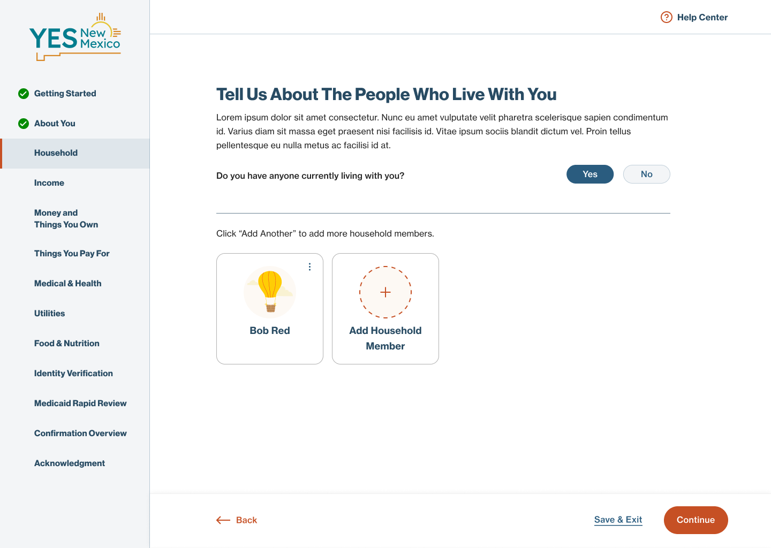
Experience
entice
enter
engage
extend
exit
I'm ready to enroll
I feel prepared to fill out my application.
I want to submit my application.
How to apply overview
Application guide
Application experience

Slide 9
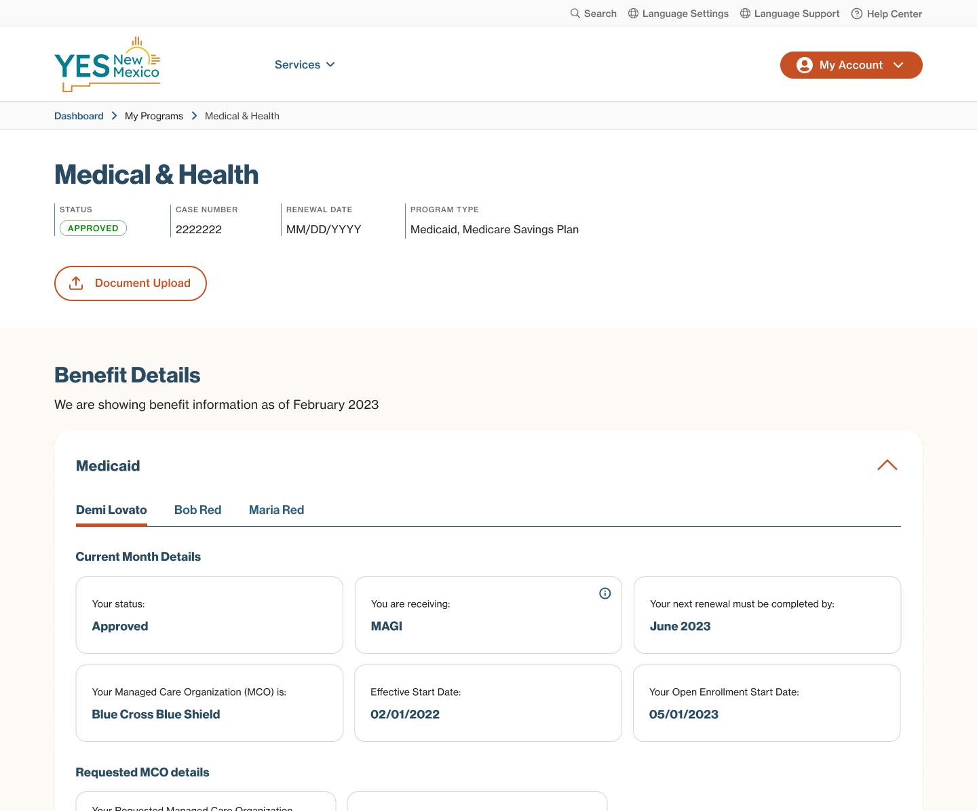
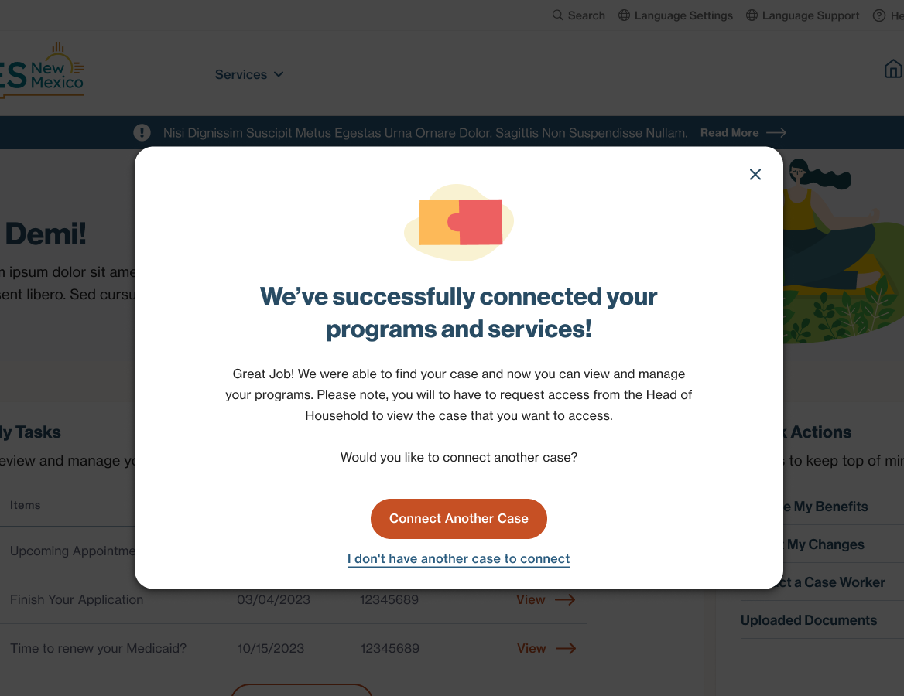
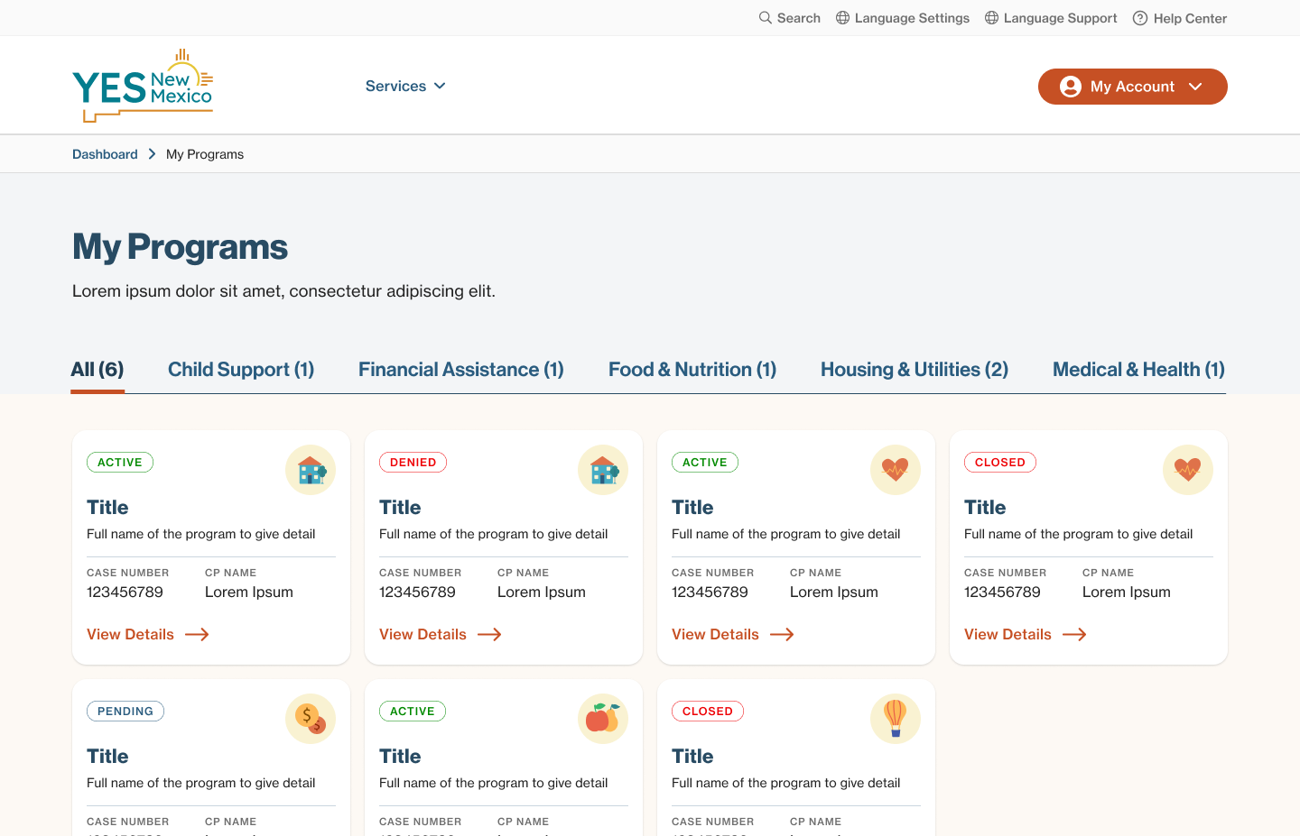
Experience
entice
enter
engage
extend
exit
I want to know if and when my application is approved.
Is my application complete?
When I will begin receiving benefits.
I want to know when I will receive child support payments.
Account dashboard
Case linking
Program status

Slide 10
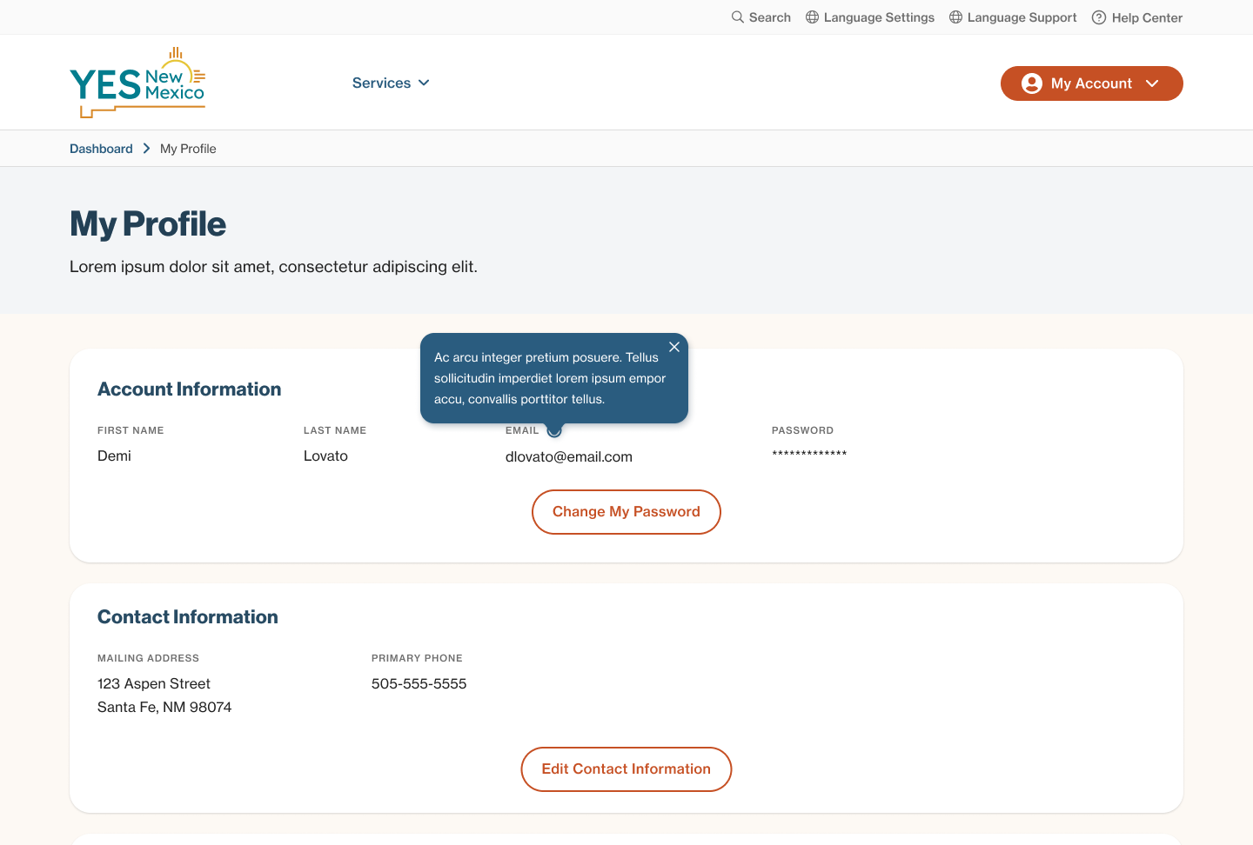
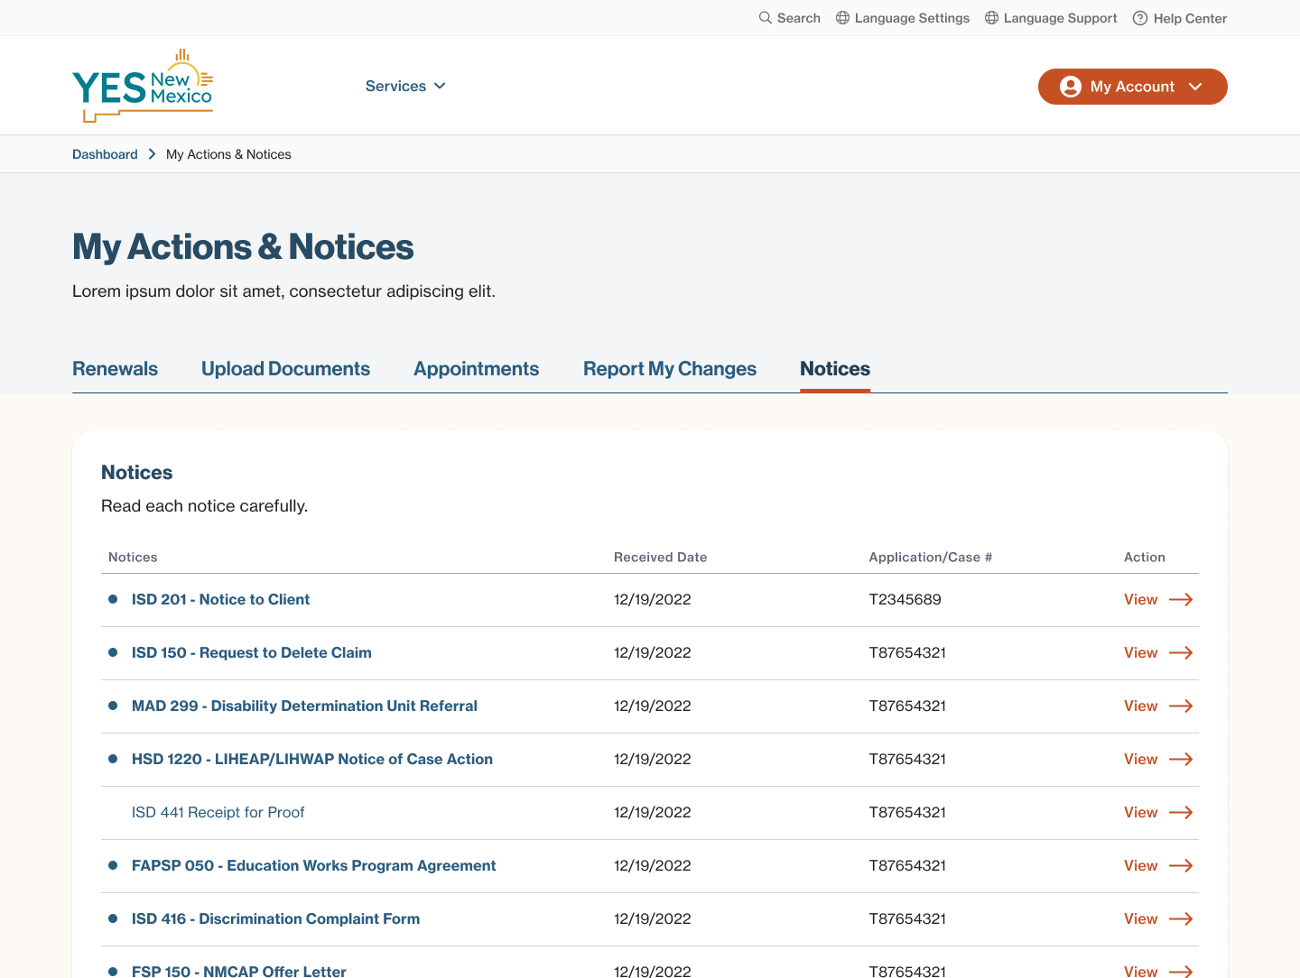
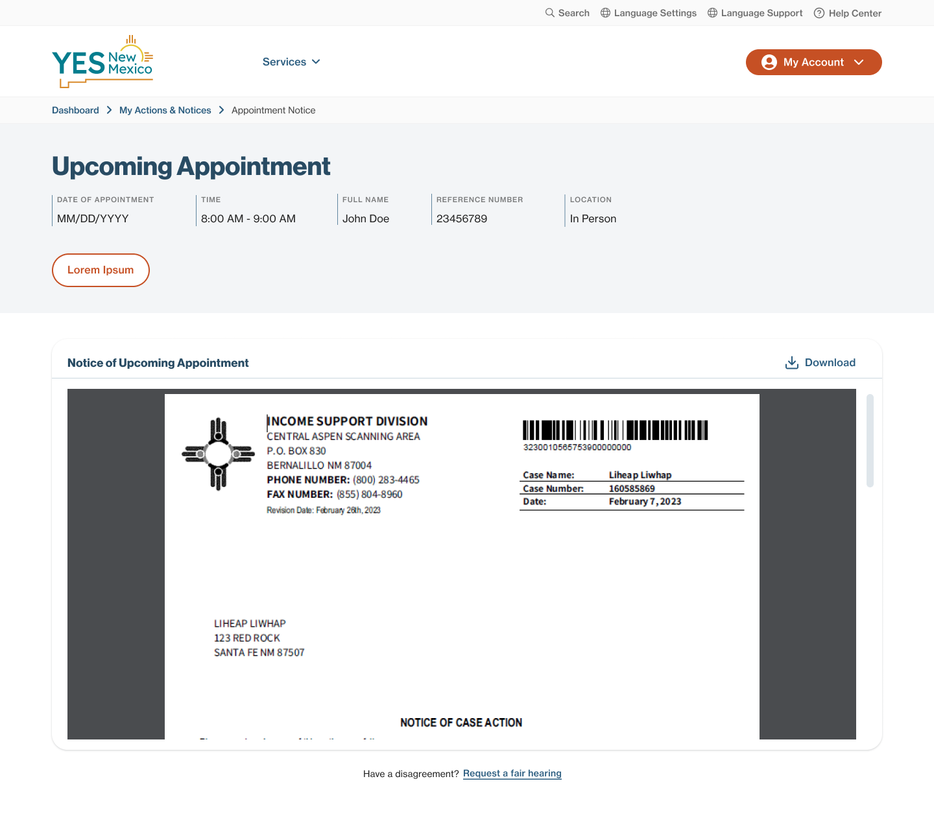
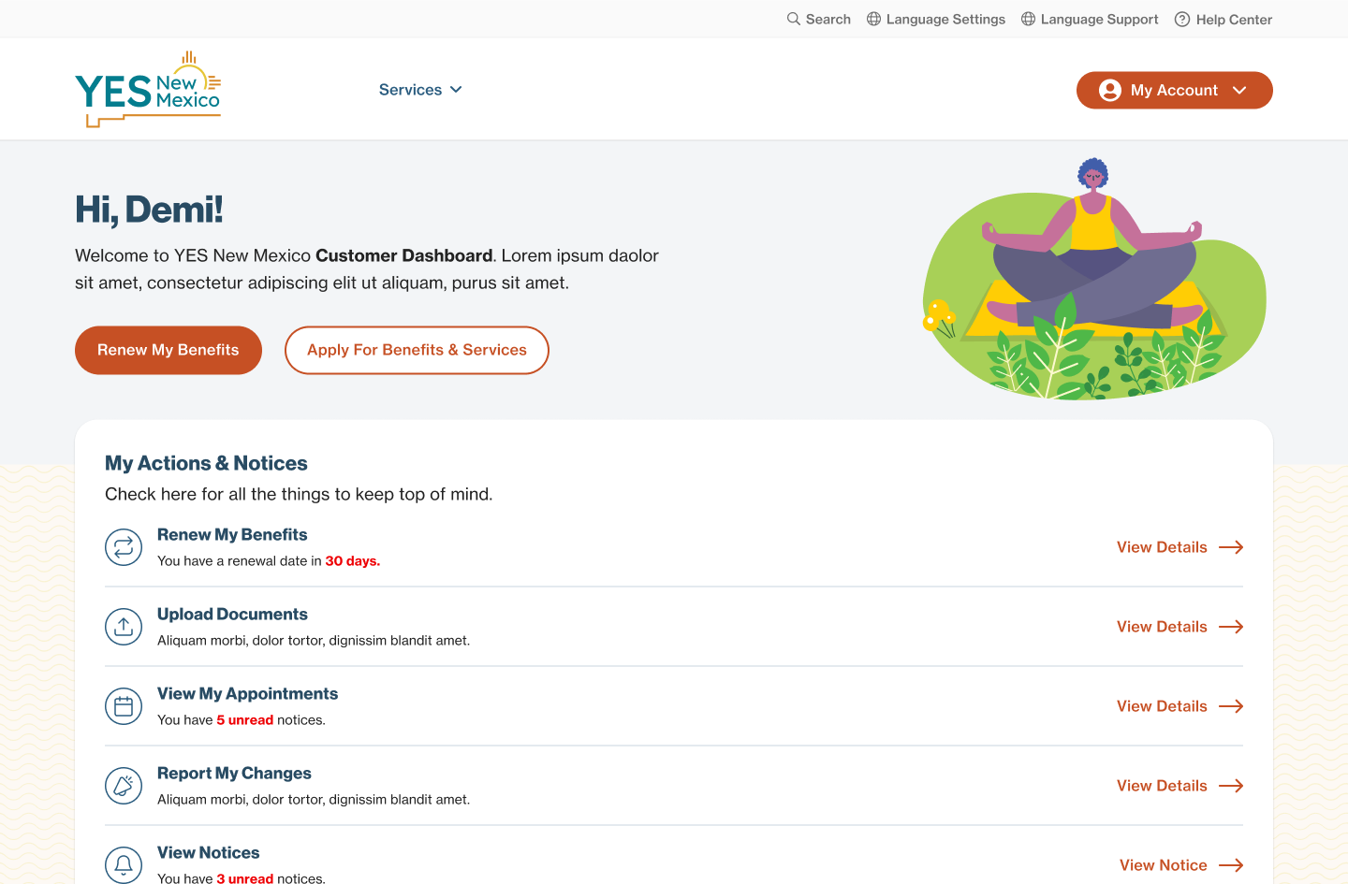
Experience
entice
enter
engage
extend
exit
I have questions about my case
I need to add members of my household
I need to renew my benefits
I want to update my personal info
Actions and notices
Standard Notices
Customer profile

Slide 11
DEMO

Slide 12
Open Forum
Questions & Answers

Slide 13
APPENDIX

