Slide 1
Health Updates
Janis Gonzales MD, MPH
ECECD Chief Health Officer

Slide 2
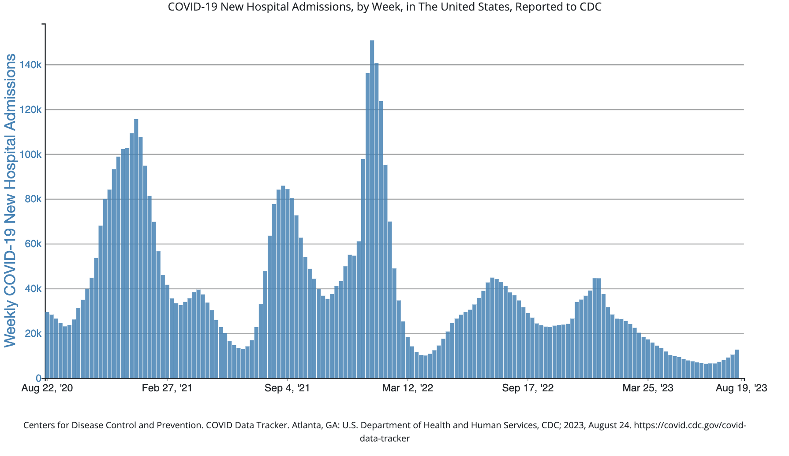
COVID-19 Hospitalizations Rising
Notes:
COVID 19 hospitalizations have been rising for 5 straight weeks and are expected to continue to rise

Slide 3

Experts Keeping Close Eye on BA.2.86 Variant
BA.2.86 is capturing the attention of public health experts around the world and has been found in Israel, the U.S., Denmark, and the U.K
The new variant has 35 mutations on the spike protein.
Per CDC, it may be better at evading prior immunity, both from vaccination and infection.
Notes:
The new variant BA.2.86 has 35 mutations on the spike protein. That’s as big of an evolutionary jump as Wuhan to Omicron. It has been found in Israel, the US, Denmark and the UK, mostly in wastewater samples. It’s harder to track now because we don’t have testing and case data like we did two years ago, but luckily this variant does show up on PCR testing. Per CDC, it may be better at evading prior immunity, both from vaccination and infection.
It’s not clear yet if this is going to cause a wave or just die out but labs will be looking for it this fall.

Slide 4

What to Expect this Fall?
COVID has still not developed a predictable pattern.
Last year RSV and Flu peaked much earlier than usual (November vs January).
RSV and Flu likely to repeat last year’s pattern based on behavior this summer in the Northern Hemisphere
BA.2.86 is the wild card

Slide 5
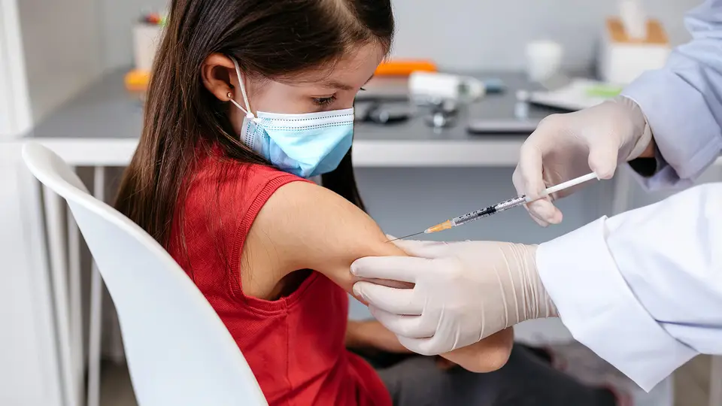
Bivalent COVID Shot Helps Youngest Kids
New study confirms benefit of bivalent (Omicron) booster in youngest kids.
In children 6 months to 5 years who had completed their primary series, a single dose of either bivalent mRNA shot yielded a vaccine effectiveness of 80% (95% CI 42-96) against ED or urgent care visits compared with no vaccination.
A single monovalent dose showed no protection, with vaccine effectiveness ranging from just 7% with the Pfizer vaccine to 23% with Moderna's shot.

Slide 6

New COVID Booster
A new booster is expected to be available by the end of September
The new vaccine will be made from the XBB.1.5 variant.
It is necessary to continue to get vaccinated as immunity wanes over time.

Slide 7
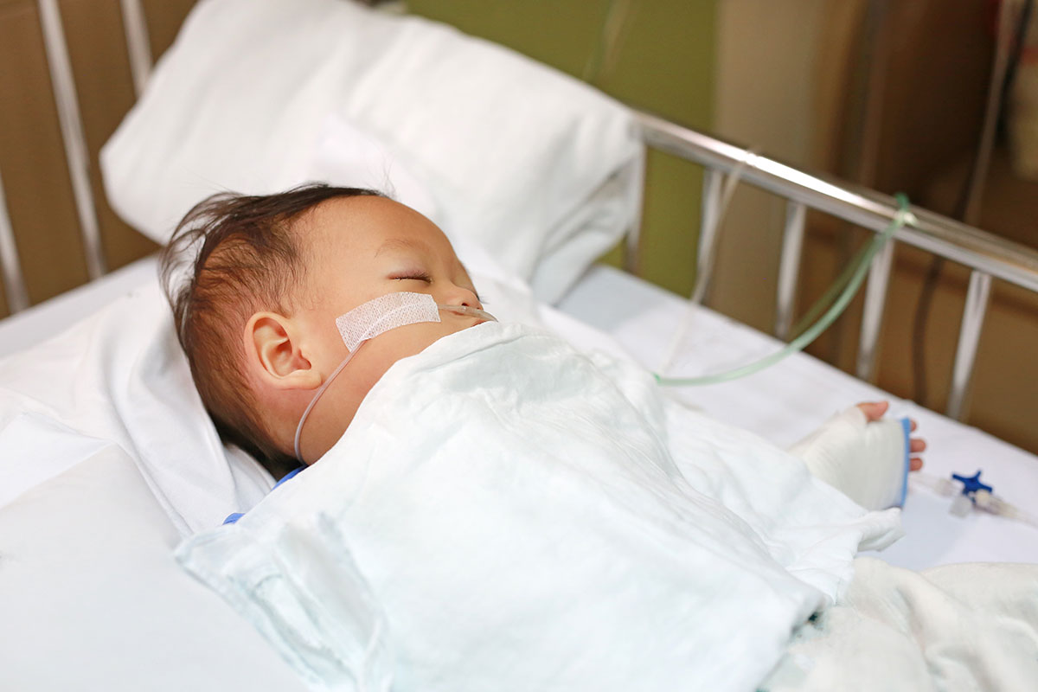
New Way to Prevent RSV in Babies
Two monoclonal antibody products – nirsevimab (Beyfortus) and palivizumab (Synagis) are now available.
Beyfortus is recommended for all infants younger than 8 months who are born during – or entering – their first RSV season (typically fall through spring). One dose can protect infants for 5 months.
Synagis is limited to children under 24 months of age with certain conditions that place them at high risk for severe RSV disease. It must be given once a month during RSV season.
Notes:
Monocolonal antibodies can help protect babies and young children from severe disease from an RSV infection. Monoclonal antibodies are not vaccines. They provide an extra layer of defense that helps fight RSV infections and protect children from getting very sick. The protection these antibodies provide wanes over time. These products are not treatments for a child who already has RSV infection.- Beyfortus can also be given to at-risk children for their second RSV season.

Slide 8
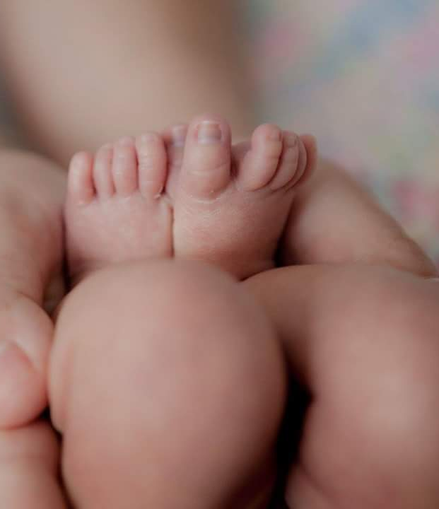
RSV Vaccine
Two RSV vaccines have been approved for adults 60 and up: one from (Abrysvo) and one from GSK (Arexvy).
Those at highest risk for severe disease include those with chronic conditions such as lung diseases, heart failure and coronary artery disease, or immunocompromise.
Pfizer's vaccine is also approved for pregnant people 32-36 weeks to protect their newborn babies against the virus.
Notes:
Not for every older adult. Need to weigh pros and cons and discuss with your physician. Space at least two weeks between RSV vaccine and flu/COVID vaccine.

Slide 9
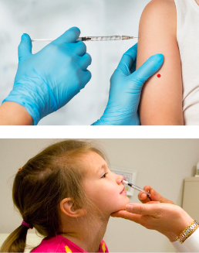
Flu vaccine Fall 2023
Recommended annually for everyone 6 months and older
The flu vaccine can come in the form of:
  An injection in the arm
  A nasal spray (available for ages 2 through 49 years old).
Best timing is Sept/Oct, especially since flu may peak earlier than usual

Slide 10
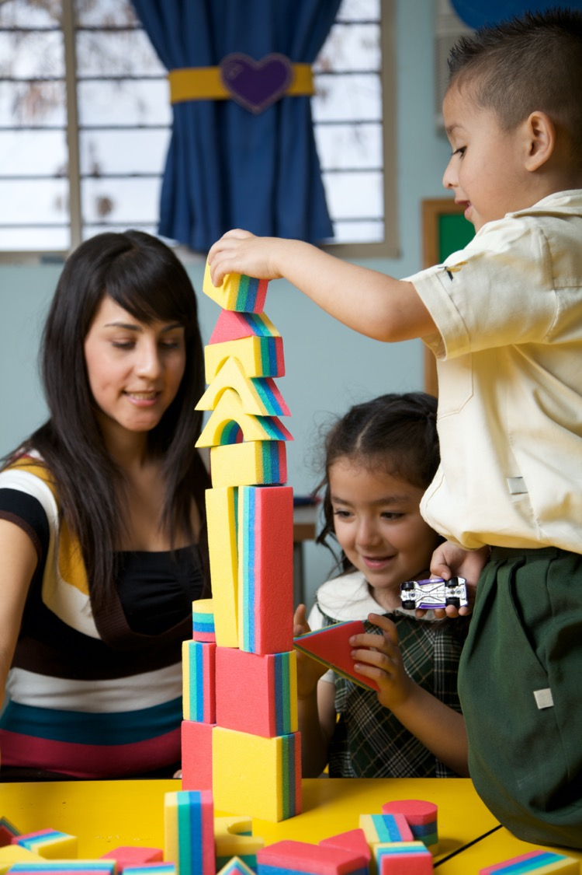

School Immunizations 2023-2024
It is highly recommended to get flu and COVID-19 vaccines, but these are not required
Reminder that parents/caregivers can check their children’s immunization record (or their own) by going to www.vaxviewnm.org

Slide 11
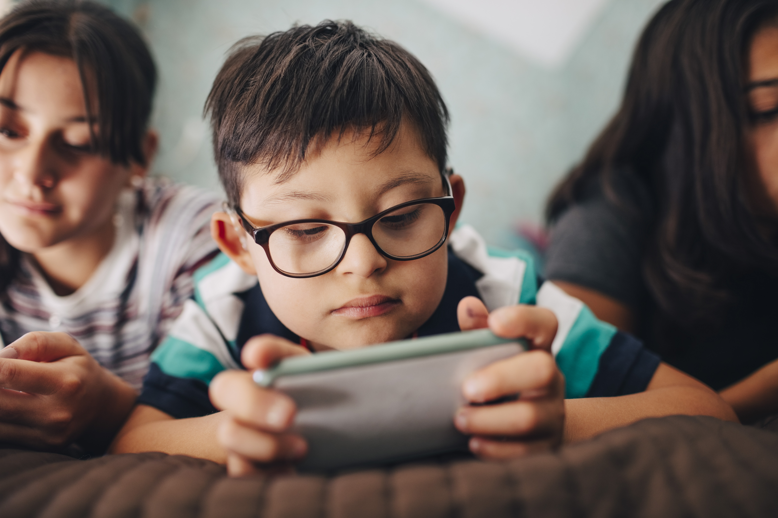
Toddler Screen Time Linked to Developmental Delays
Japanese study of over 7000 children was published in JAMA
Greater screen time for children 1 year of age was associated with developmental delays at 2 and 4 years of age
The AAP recommends no screen time under 18 months and a limit of one hour per day for children 2-5
Notes:
Communication, fine motor skills, problem solving and social skills were all significantly associated with screen time of two hours or more

Slide 12
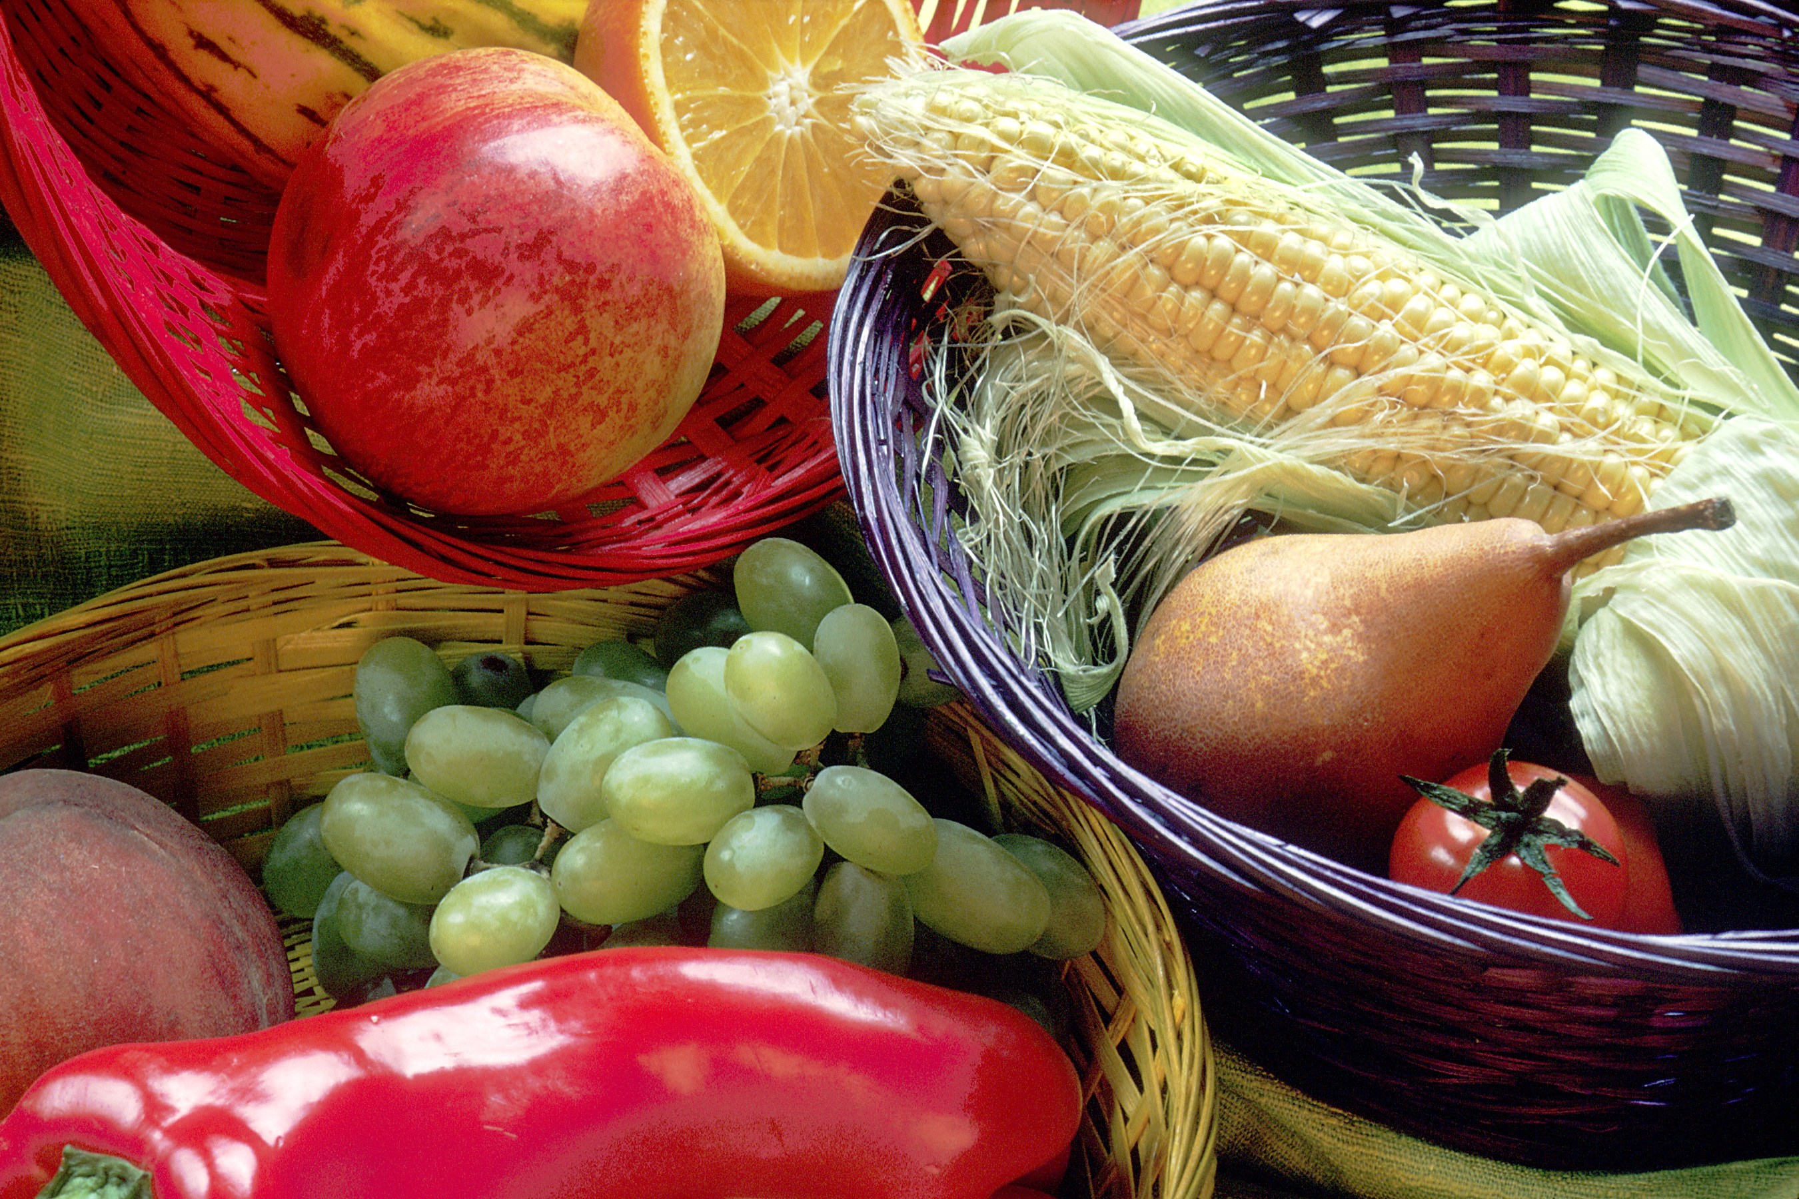
Increases in BMI Linked to COVID Pandemic
Rates of pediatric obesity reached new highs during the COVID pandemic compared to prior years.
Factors include changes in routine, increased stress, and decrease in exercise.
On average, overall obesity prevalence increased from 13.7% (June to December 2019) to 15.4% (June to December 2020).
This increase was more pronounced in patients aged 5 to 9 years and those who were Hispanic, non-Hispanic Black, publicly insured, or lower income

Slide 13
For more information, please contact
Janis Gonzales MD, MPH
Phone: 505-469-1742
Email: Janis.Gonzales2@ececd.nm.gov

