Slide 1
ECECD Background Check Process
Background Check Fees Update

Slide 2
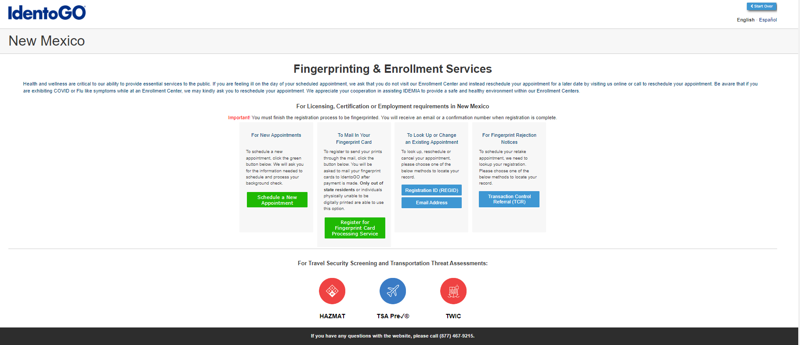
NM ECECD Background Check Unit process to waive the fingerprint registration fee for Child Care Providers
https://nm.state.identogo.com

Slide 3
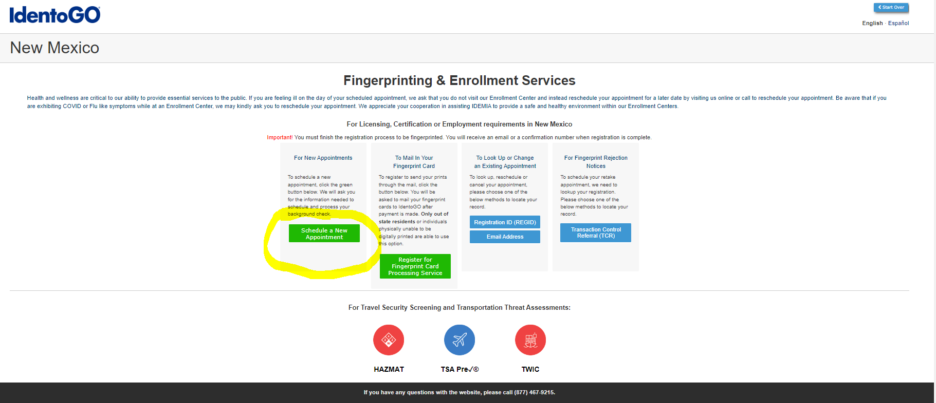
To register applicant for fingerprinting select “Schedule a New Appointment”

Slide 4
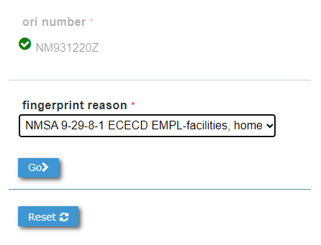
Enter ORI Number and fingerprint reason based on options below and select Go
Fingerprint Reasons:
5-year background check renewal, select: NMSA 9-29-8-1 ECECD EMPL-facilities, home programs, depart-cont prov
Volunteer, select: NMSA 9-29-8-1 ECECD VOLS-facilities, home programs, depart-cont prov
New Applicant, select: NMSA 9-29-8-1 ECECD applicant facility/home program

Slide 5
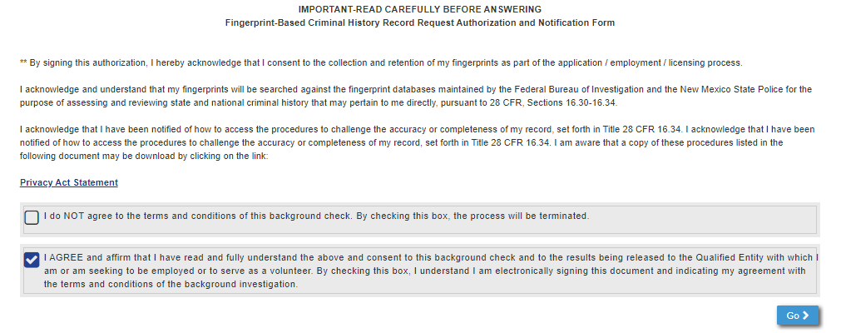
Sign authorization form and select Go

Slide 6
Select Location by Zip Code

Slide 7
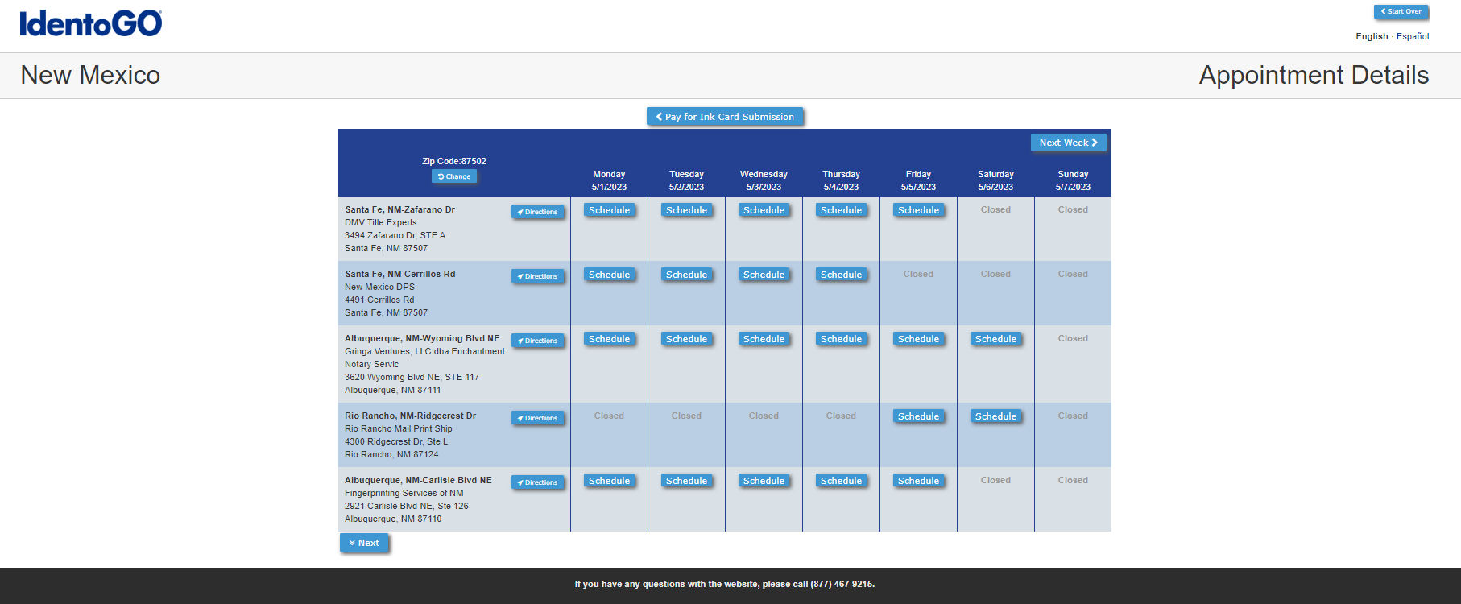
Schedule Appointment for Fingerprinting

Slide 8
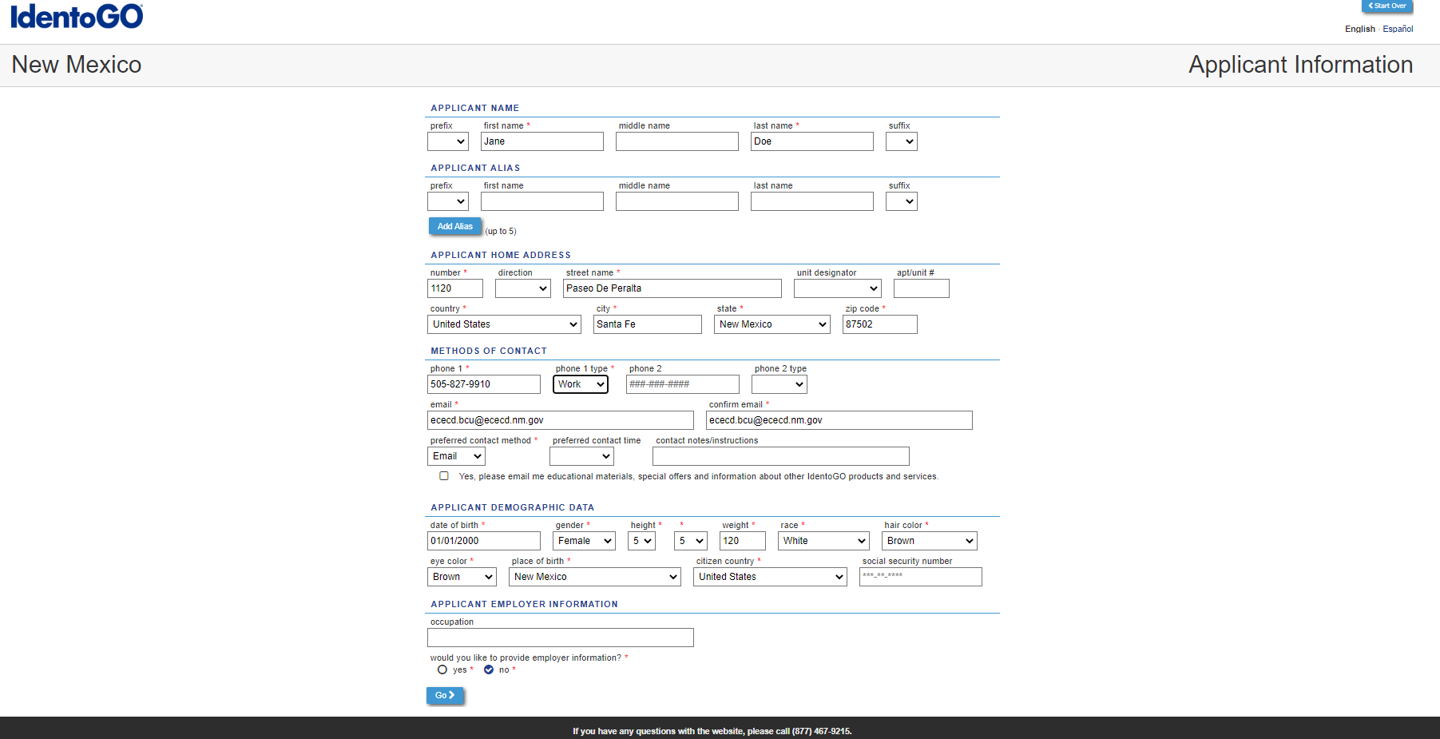
Enter Applicant Contact and Demographic Information

Slide 9
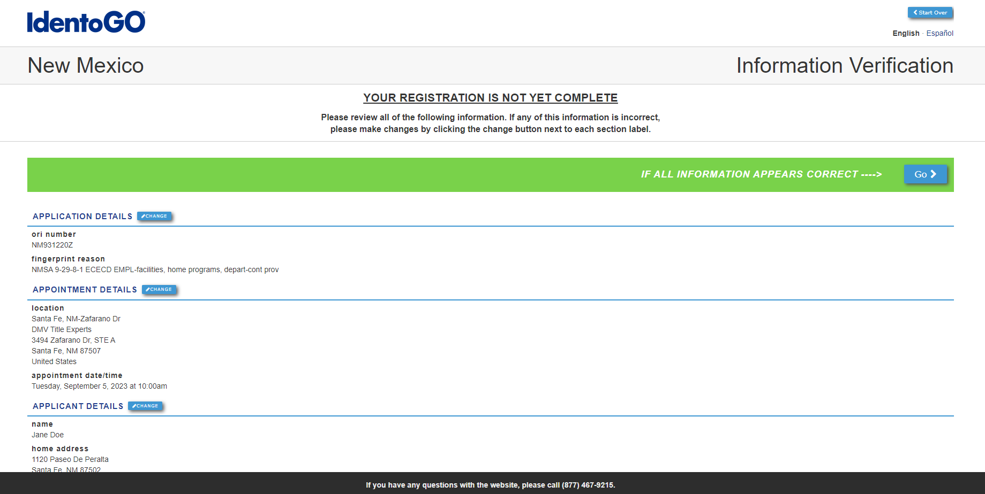
Confirm Entries prior to selecting Go

Slide 10
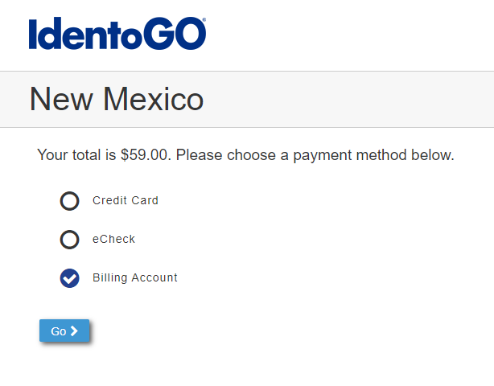
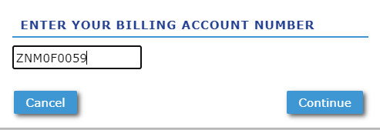
Select Billing Account for Payment Method
(Note: Please ensure all your information has been entered correctly prior to submitting)
You cannot go back once you select Continue

Slide 11
Next Steps: Once submitted Fingerprint receipt will be emailed to address provided during registration - Applicant must be fingerprinted at location selected on the date and time - Once applicant has been fingerprinted, please submit appropriate ECECD Background Check application to: ECECD.BCU@ececd.nm.gov
Updated applications can be found at: https://www.nmececd.org/comprehensive-background-check-process/

Slide 12
Notice: ECECD Background Check Unit will no longer accept fingerprint submissions other than the ECECD ORI below: ECECD ORI number is: NM931220Z Billing Account Number: ZNM0F0059

Slide 13
Questions? Contact: ECECD Background Check Unit ECECD.BCU@ececd.nm.gov 505-827-9910

